Slide 1

PVLDB, 18(11), 2025. https://github.com/Nazanin-Rashedi/CE_Accuracy

Slide 2
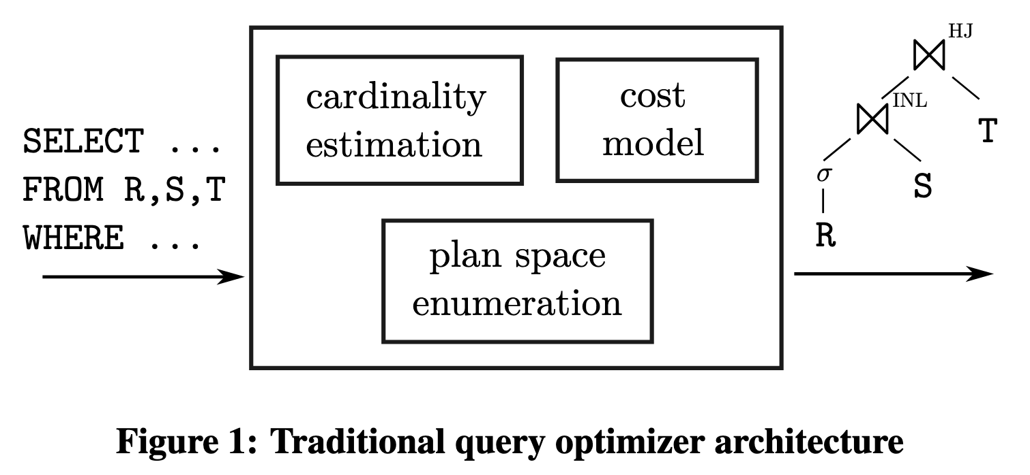
Cardinality Estimation (CardEst)
To obtain an efficient query plan, the query optimizer enumerates some subset of the valid join orders, for example using dynamic programming. Using cardinality estimates as its principal input, the cost model then chooses the cheapest alternative from semantically equivalent plan alternatives.
[1] Leis, Viktor, et al. "How good are query optimizers, really?." Proceedings of the VLDB Endowment 9.3 (2015): 204-215.

Slide 3
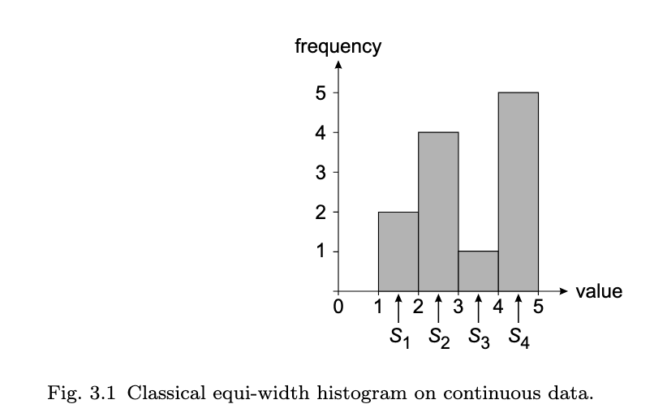
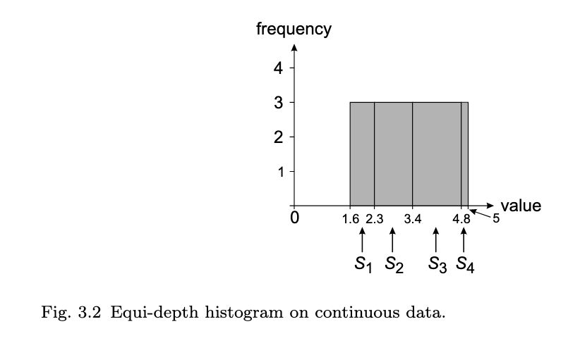
Traditional Method for CardEst
Traditional cardinality estimators primarily rely on histograms and sampling techniques.

Slide 4
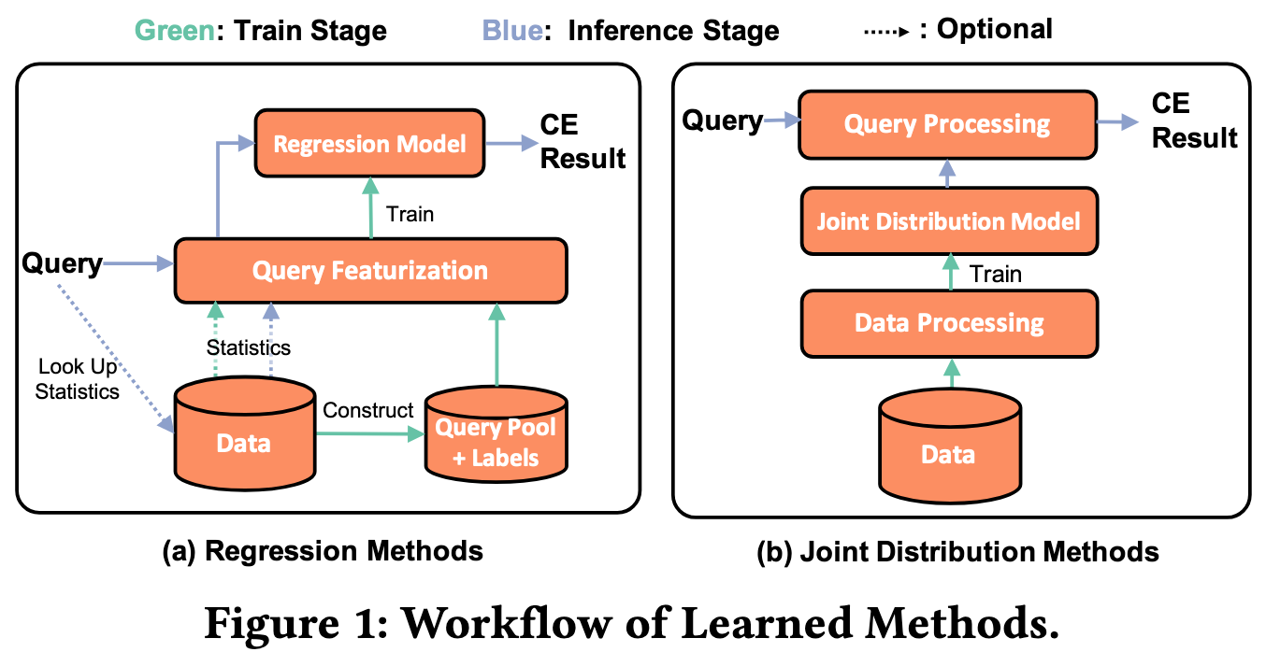
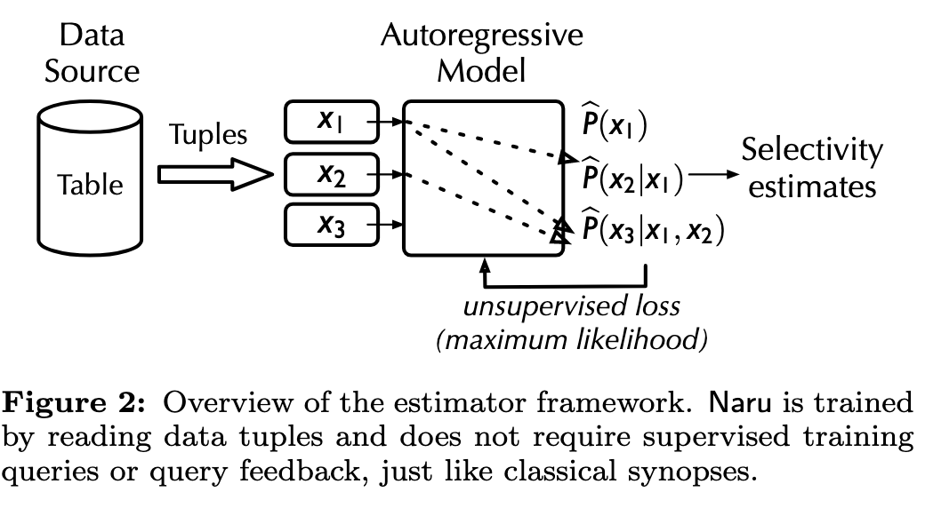
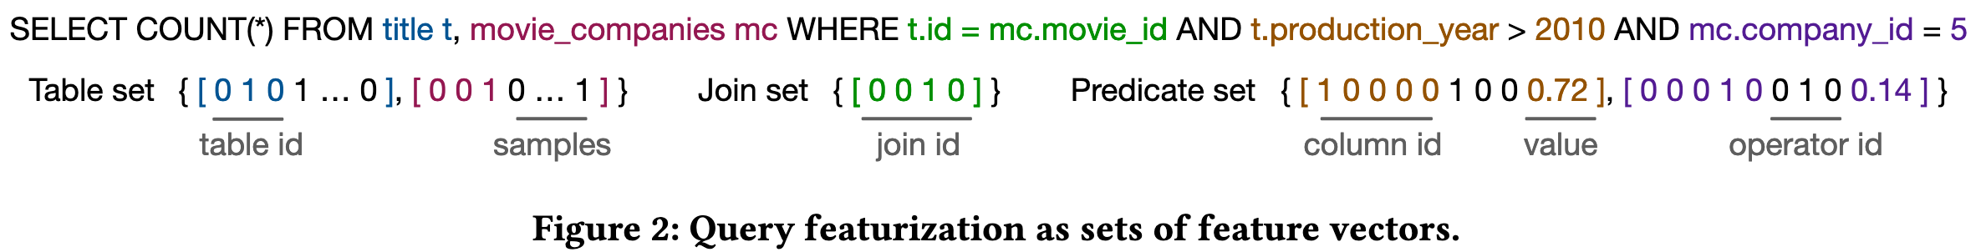
Learned Method for CardEst
data driven
query driven

Slide 5
Contribution
MDE - Multidimensional Evaluation Propose a multidimensional evaluation framework (MDE) that leverages discretization to establish a solid foundation for aggregating the evaluation results across diverse datasets.
Correcting Bias: Revealing and Addressing Unfair Comparisons Highlight that many previous comparisons between learned and traditional estimators fail to adequately consider the potential tuning knobs of traditional methods.
Algorithmic Improvements: Two Enhanced Estimator Variants EXGB, an improved version of the lightweight XGBoost estimator LW-XGB. QTS-2, a new variant of the traditional QTS method.
Practical Insights: Counter-Intuitive Benchmark Findings Conduct a benchmarking study within a well-defined yet practical scope for the experimental datasets and workload.

Slide 6
Scope
Data Model & Query Type
single relation, range predicates
Data Type & Dimensionality
2-dimensional, geographical gatasets
Reason: The focus on 2-D geographical datasets is motivated by their widespread availability and the broad range of applications. The crucial role of these datasets in industries like urban planning, transportation, and disaster management has led to the development of tailored cardinality estimators and database extensions, some of which are included in this study.
Environment
static environment

Slide 7
Datasets
We utilize a repository of 18,020 datasets, each containing the longitude (X) and latitude (Y) of datapoints collected from the snapshot of three sets of datasets namely Earthquake, OpenStreetMap, and Tiger in the year 2013.
We consider two subsets from these datasets:
S1: The subset with 5 datasets.
S2: The subset of 276 datasets.

Slide 8
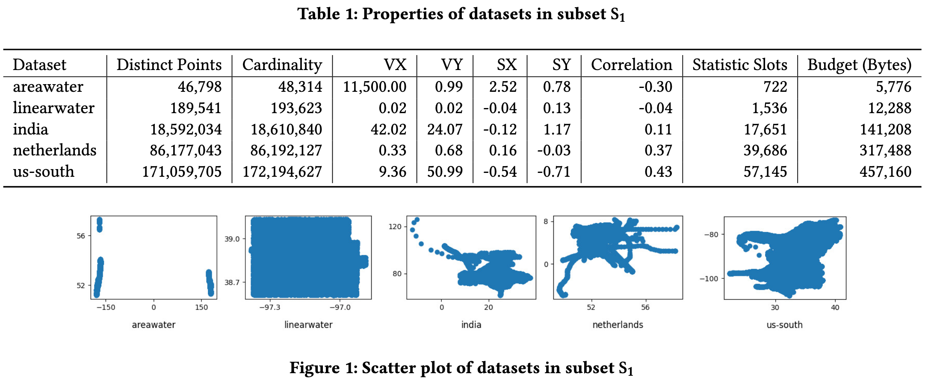
Datasets
Number of distinct datapoints, total cardinality, variance (VX and VY), skewness (SX and SY), and the correlation between columns for each dataset. For skewness and correlation, we consider the Fisher-Pearson coefficient of skewness and the Pearson correlation coefficient.
For dataset selection, we employ KMeans clustering preceded by a principal component analysis (PCA), a beneficial technique for enhancing clustering performance.

Slide 9
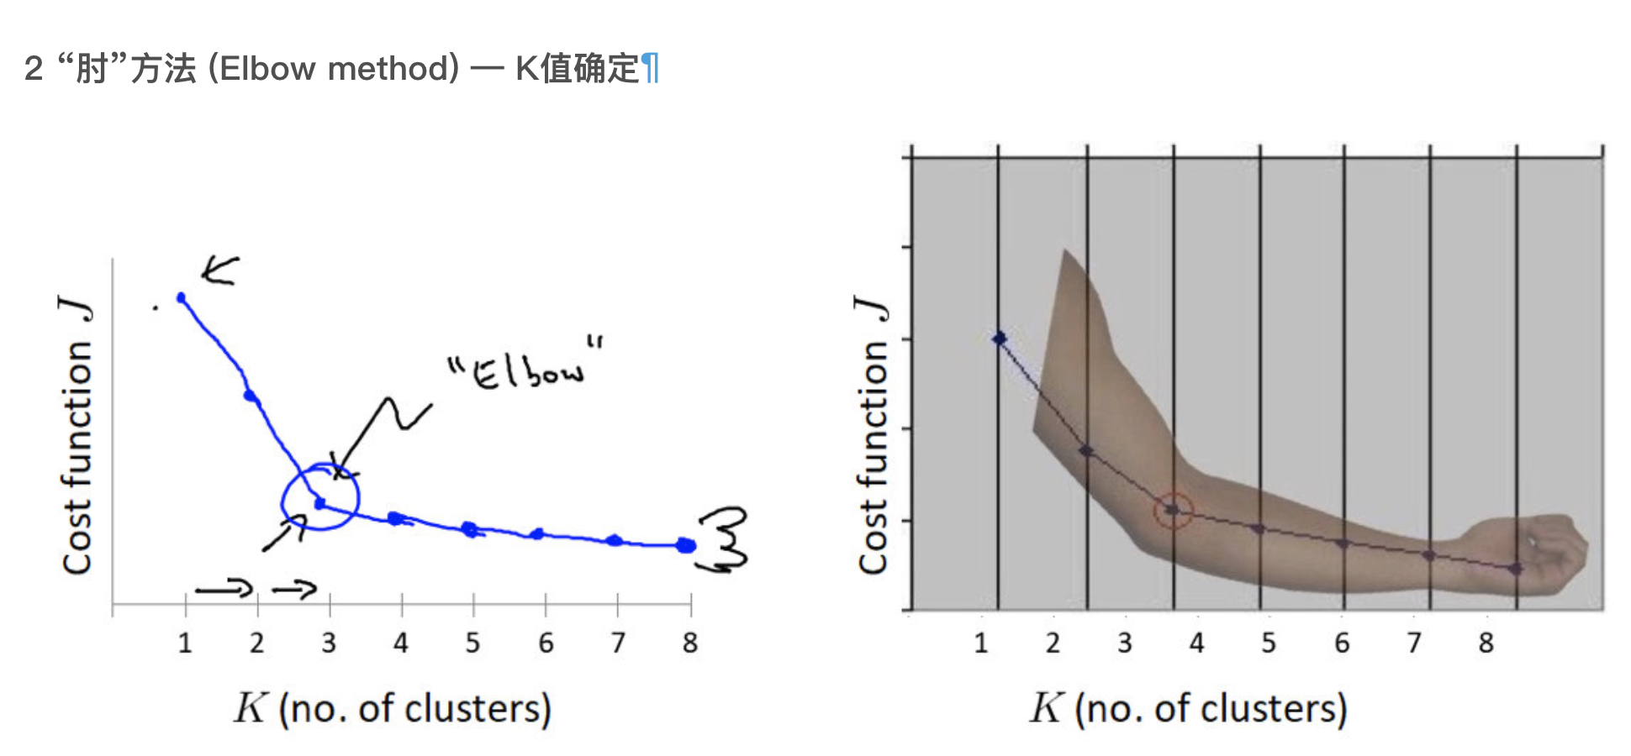

Slide 10
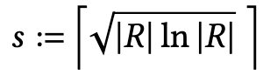
Per-Dataset Budget Assignment
Wang et al. [1] and Yang et al. [2] suggest the budget limits of 1.5% and 1% of the dataset size, respectively. Nevertheless, for a real-world dataset that can easily reach 1 TB in size, allocating 10 to 15 GB to a cardinality estimator is excessive.
Instead, we suggest a budget constraint of s statistic slots, each accommodating two 32-bit floating-point values, where s is determined by the dataset’s cardinality |R|:
The sublinearity of this function prevents huge storage assignments to large datasets, while allowing smaller datasets to gain a proper budget.
[1] Xiaoying Wang and et al. Are We Ready For Learned Cardinality Estimation? VLDB. 2021.
[2] Zongheng Yang and et al. Deep Unsupervised Cardinality Estimation. VLDB. 2019.

Slide 11
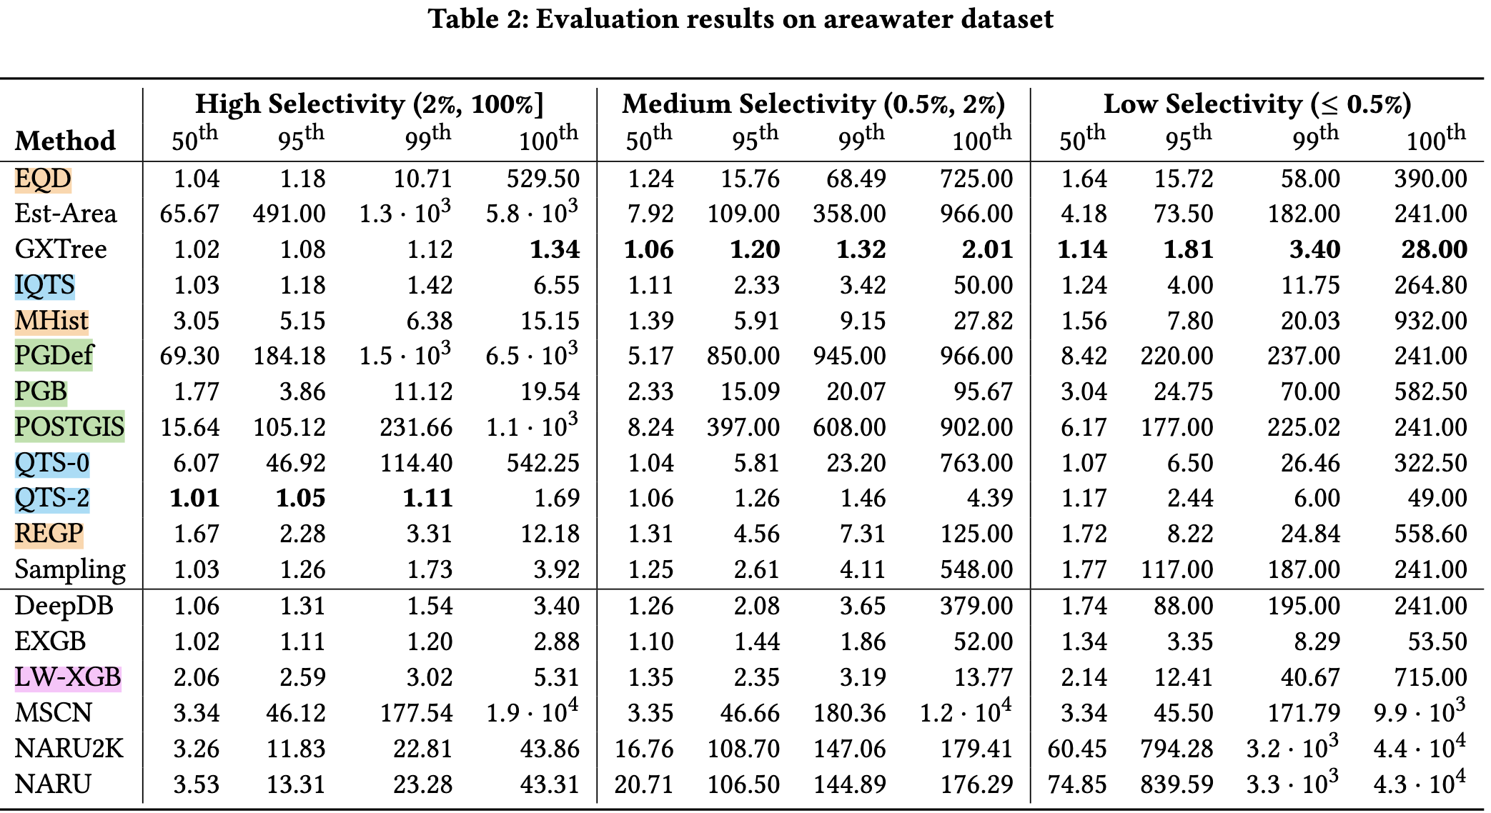
Per-dataset evaluation (PDE)

Slide 12
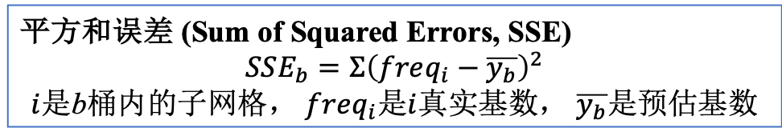
特性 | QTS 家族 (QTS-0, QTS-2, IQTS) | GXTree
构建方向 | 自顶向下 | 自底向上
核心操作 | 分裂 | 合并
底层结构 | 四叉树 | 常规网格
区域形状 | 总是矩形 | 任意形状
决策标准 | 选择“最值得分裂”的区域 QTS-0: 最大SSE IQTS: 最大方差 QTS-2: 最大基数 | 选择“最适合合并”的区域 最小化SSE增加
平方和误差 (Sum of Squared Errors, SSE)
$$SSE_{b}=Σ{\left(freq_{i}−\overline{y_{b}}\right)}^{2}$$ $i$是b桶内的子网格， $freq_{i}$是$i$真实基数， $\overline{y_{b}}$是预估基数
等深 2-D Hist
2-D Hist， Maxdiff桶分裂策略（使得分裂后SSE 最小），一分为二
PG默认， 1D Hist ，100个桶
PG， 1D Hist ，s个桶
PG对地理空间数据的扩展
等宽 2D Hist
Est-Area 只存储5个值，（基数，X_min ，X_max ，Y_min ，Y_max ）

Slide 13
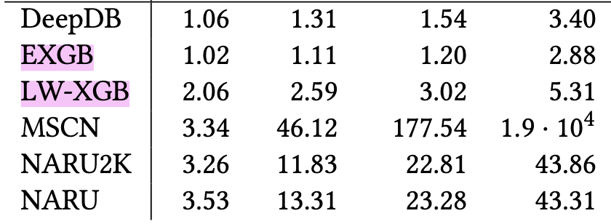
Per-dataset evaluation (PDE)
相较于LW-XGB，作者提出的EXGB改进主要是2点。
1.使用二维数据特征，即，Est-Area 和 Sampling。
2.增加模型复杂度并加强正则化。LW-XGB最多 16 棵树，每棵树最大深度为 4。EXGB最多300棵树，树深度为3，且加入了正则化来防止过拟合。
数据驱动，和积网络
查询驱动，FCN
数据驱动，深度自回归

Slide 14
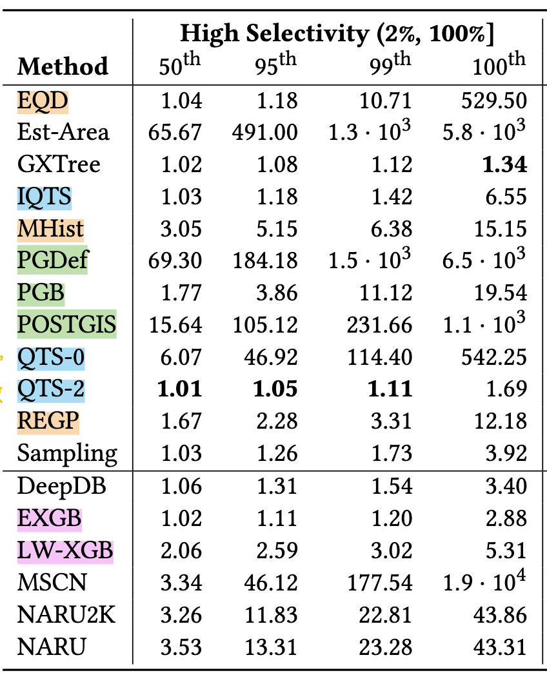
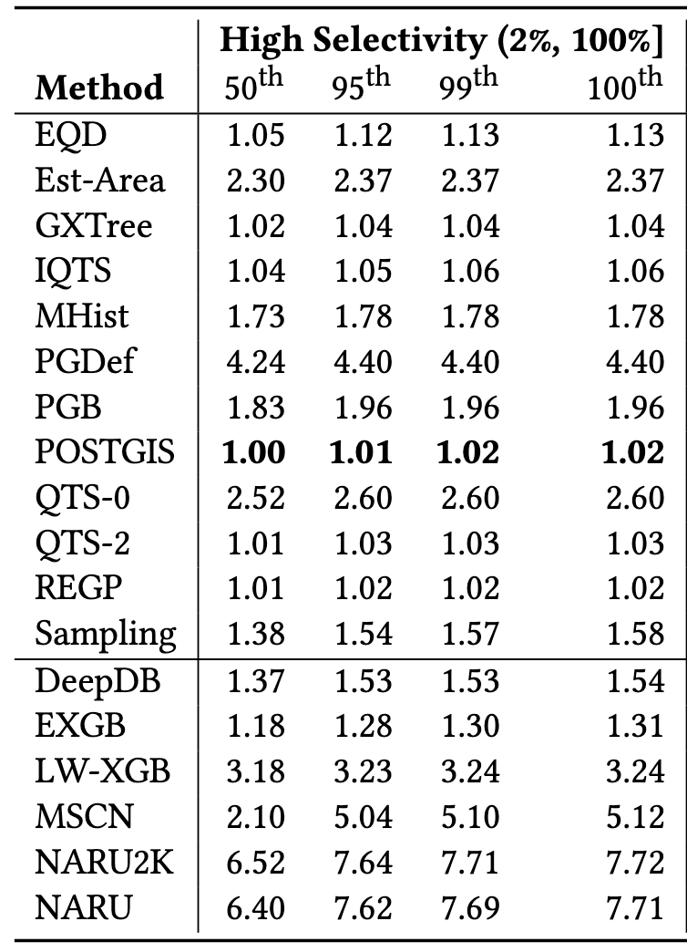
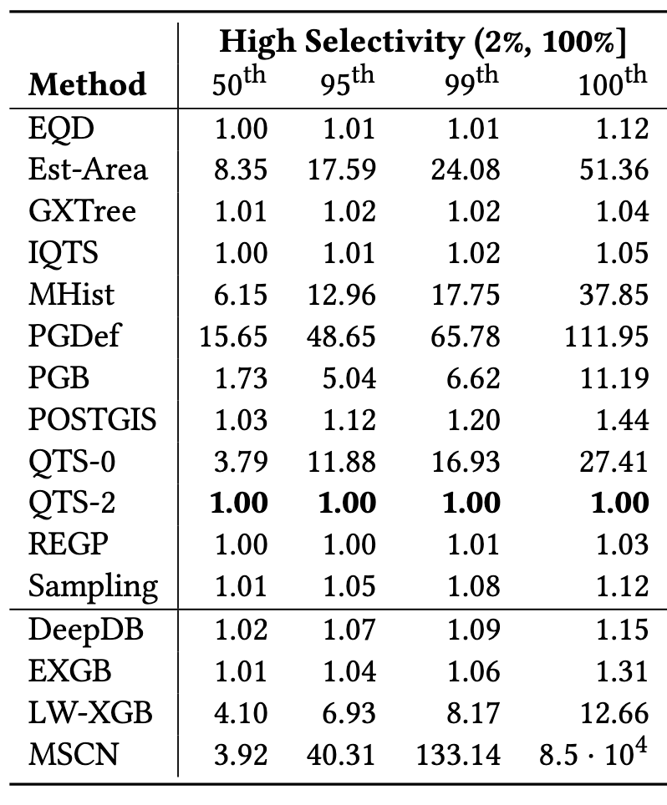
Per-dataset evaluation (PDE)
us-south dataset
areawater dataset
linearwater dataset

Slide 15
Limitations of PDE
Not Scalable:
Experiments are restricted to a handful of datasets.
Not Aggregable:
The data entries in similar PDE segments (those sharing the same percentile levels and selectivity categories) are neither comparable nor aggregable across different datasets.
Notably, the impact of a specific q-error is heavily influenced by the true cardinality of the corresponding query.
Information Poor:
Result tables only show q-error percentiles.
Critical context is lost: How frequent are extreme errors?
Evaluation Conundrum
Conflicting outcomes, where one estimator outperforms another on certain datasets, but not on other datasets.

Slide 16
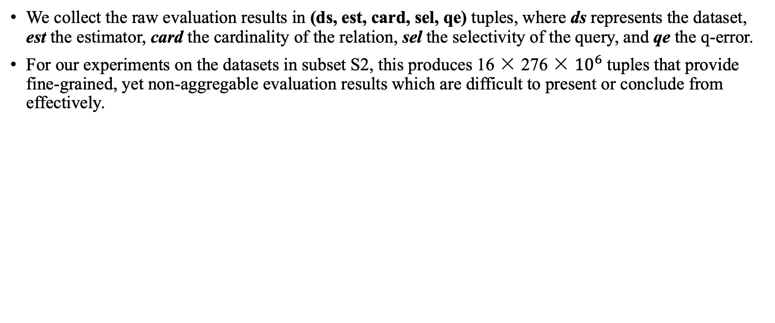
Multidimensional Evaluation (MDE)
We collect the raw evaluation results in (ds, est, card, sel, qe) tuples, where ds represents the dataset, est the estimator, card the cardinality of the relation, sel the selectivity of the query, and qe the q-error.
For our experiments on the datasets in subset S2, this produces 16 × 276 × ${10}^{6}$ tuples that provide fine-grained, yet non-aggregable evaluation results which are difficult to present or conclude from effectively.

Slide 17
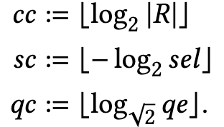
Multidimensional Evaluation (MDE)
We collect the raw evaluation results in (ds, est, card, sel, qe) tuples, where ds represents the dataset, est the estimator, card the cardinality of the relation, sel the selectivity of the query, and qe the q-error.
In order to provide the necessary foundation for aggregation, we apply discretization. For a relation R with cardinality |R|, we define the cardinality class of the relation (cc), the selectivity class of the query (sc), and the q-error class of the estimate (qc) as follows:
Define multidimensional profile (MDP): MDP (ds, est, cc, sc, qc, cnt).
所有 (cc, sc) 值相同的查询，无论它们来自哪个具体的数据集，它们的真实基数都在同一个数量级。解决PDE不可聚集，不可比较的问题。

Slide 18
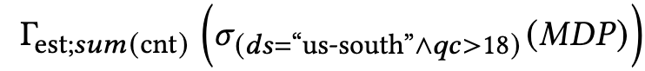
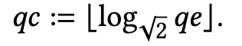
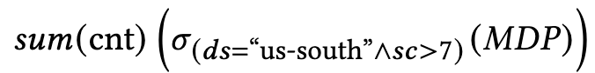
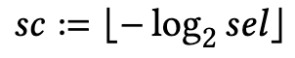
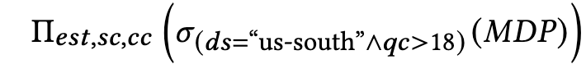
Multidimensional Evaluation (MDE)
Q1) How often do such high-end q-errors, for instance q-errors larger than 512, occur per estimator?
Q2) How many low-selectivity (sc=0.5%) queries did our query generator produce for this dataset?
Q3) What are the true cardinalities of these misestimated queries, given that they can range from 1 to 860,973 tuples?

Slide 19
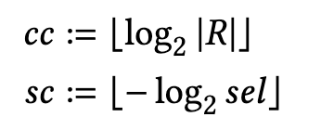
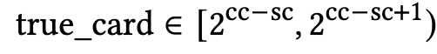
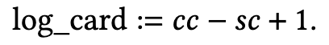
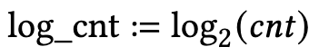
Accuracy Heatmaps
Apply dimensionality reduction of MDP (ds, est, cc, sc, qc, cnt) to present or draw a conclusion from. We use the log-transformed upper bound of the approximation interval presented for true cardinalities, defined as log_card. For better visualization, we define log_cnt:
For each estimator, we use the aggregated (log_card, qc, log_cnt) tuples to plot the accuracy heatmaps.

Slide 20
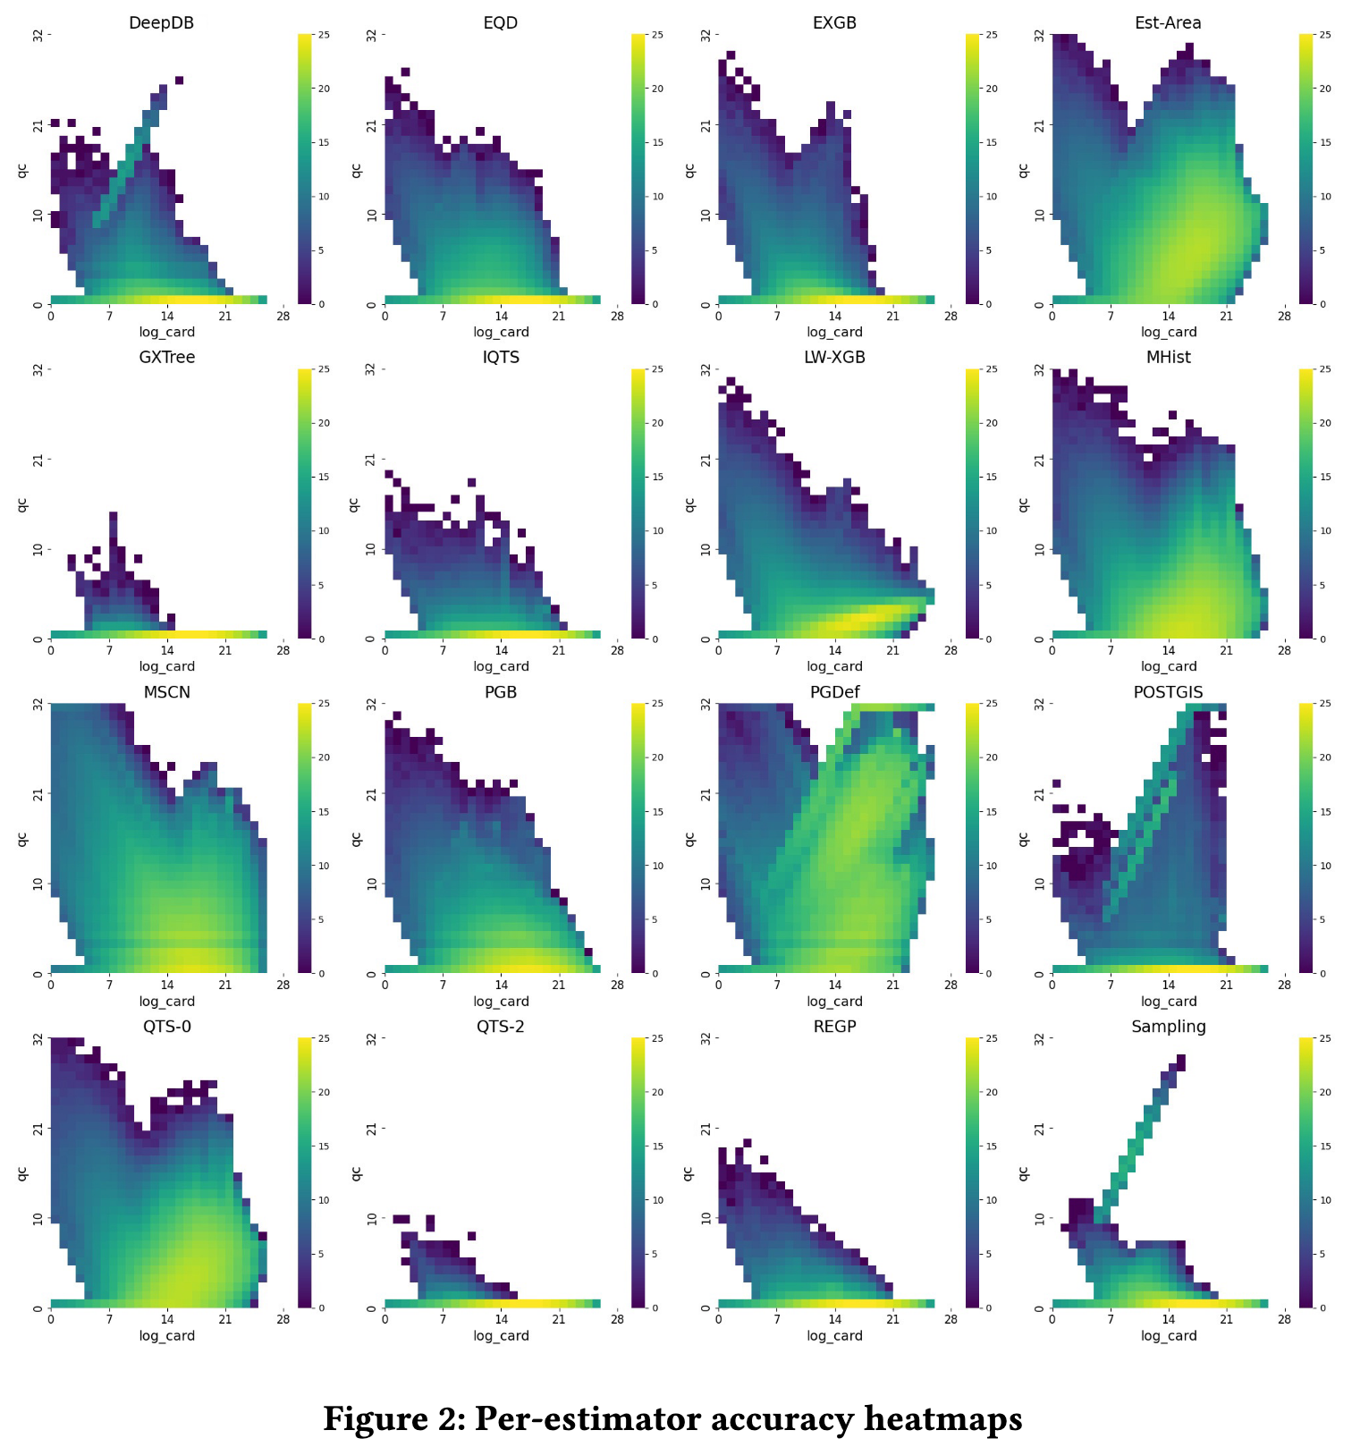
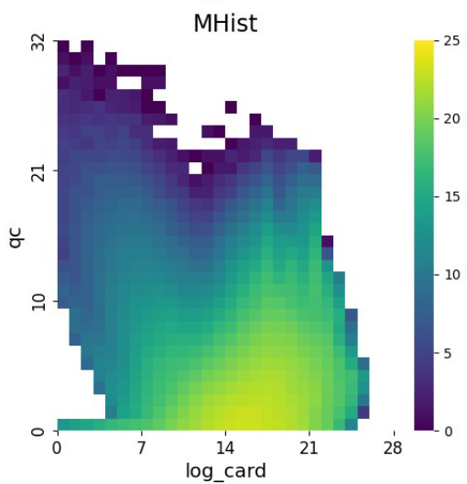
大
多
预 估 误 差
查 询 数 量
小
少
查询基数
小
大

Slide 21
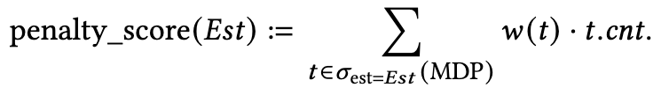
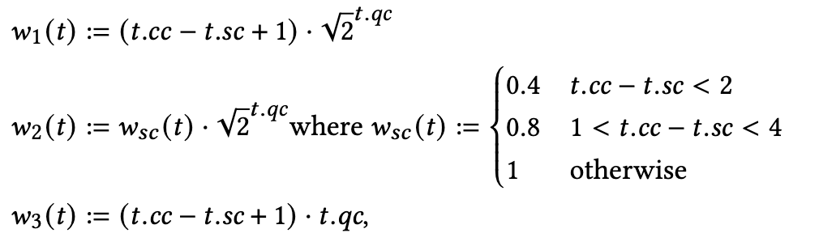
From MDP to Ranking the Estimators
We use the MDP tuples and a weighted sum to derive a penalty score per estimator. For an estimator Est, a tuple t in MDP, and a weight function w(t),
Some recommendations for the weighting mechanism are:
t: 这里的 t 是一个 MDP 元组，t = (ds, est, cc, sc, qc)。
t.cnt: 是这个元组的频率。
w(t): 这是一个具体的、多变量的权重函数。它不再仅仅是 qc 的函数，而是整个元组 t 的函数。
Σ: 这个求和是遍历一个估算器在 MDP 中的所有元组，涵盖了所有的 cc, sc, qc 组合。

Slide 22
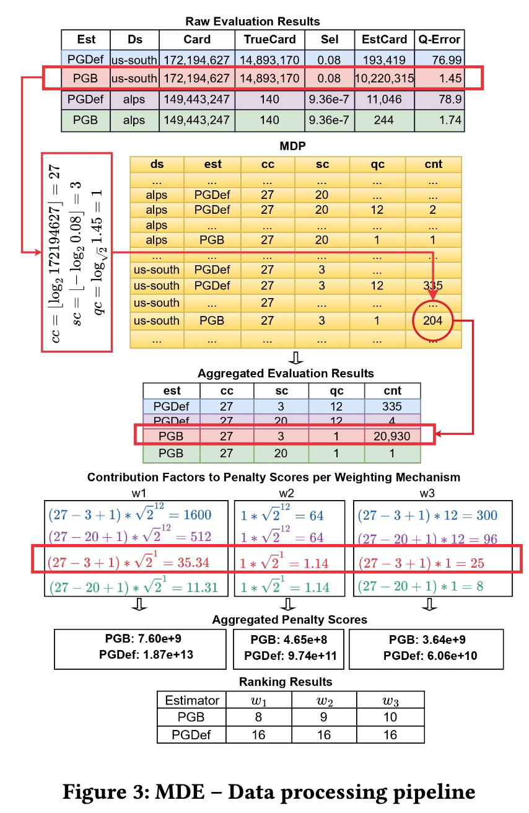
Case Study
离散化和初步聚合
跨数据集聚合

Slide 23
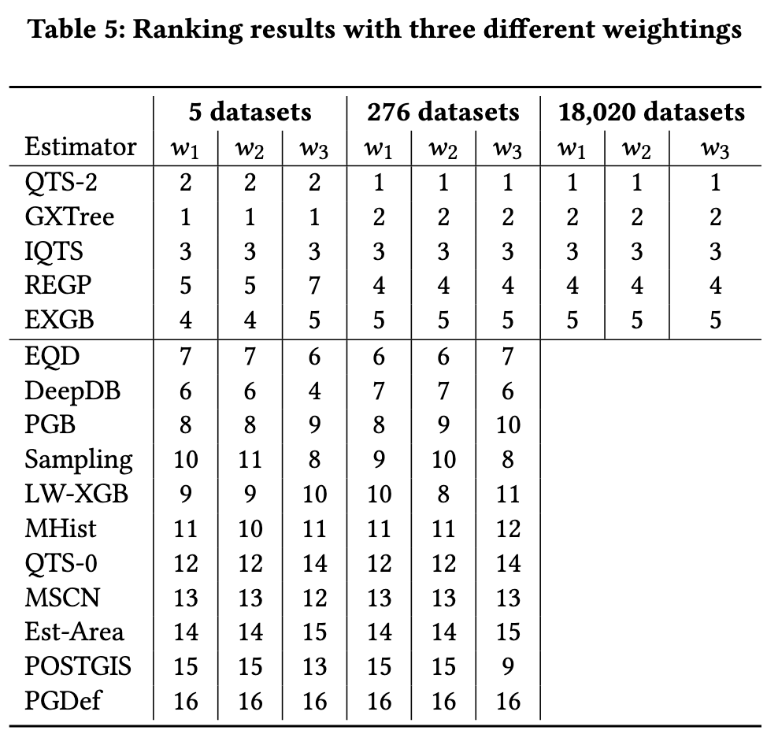
Estimators’ Ranking
The overall ranking remains mostly stable, with the top estimators largely remaining in the top tier and those in the middle or bottom exhibiting similar standing. This suggests that the K-Means selection was quite effective in choosing a representative subset of only five datasets, capturing the diversity of our repository.

